Slide 1

UD_ARULE CLI & Python Implementation

Slide 2
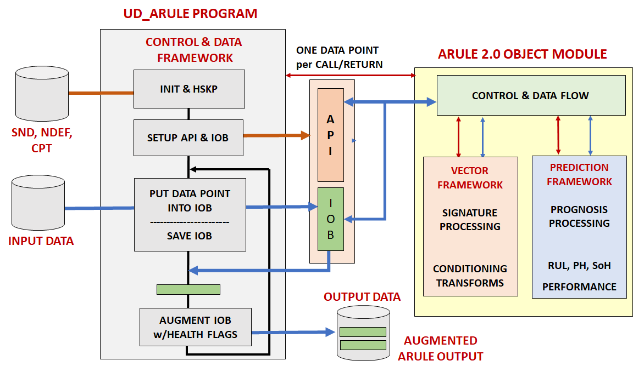
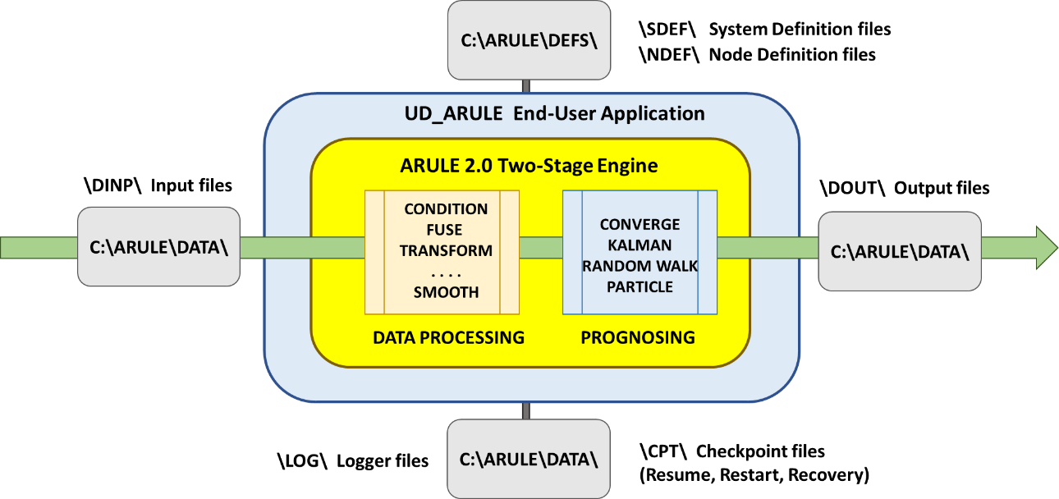
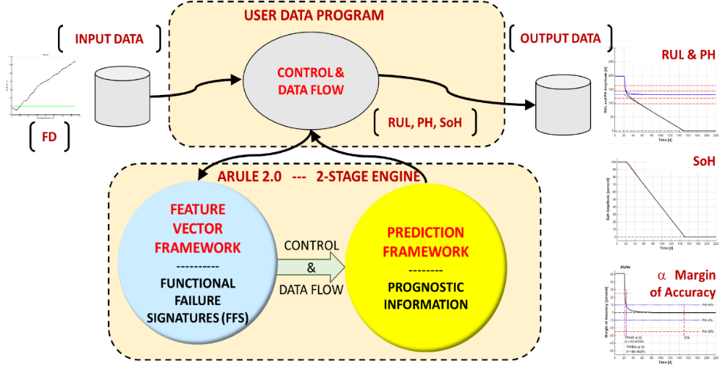
UD_ARULE Description
Block Diagram of UD_ARULE and ARULE showing Control & Data Flow
UD_ARULE: A framework for run-time operation
UD_ARULE is an executable program that uses ARULE 2.0 (an object module). The processing and control of UD_ARULE and ARULE is driven by tables created from definition files: the tables are kept in work files - program (PW), data (DW), and ARULE (AW).
The underlying Adaptive Predictive Kernel (APK) within ARULE is a command-line interface (CLI) program that can be embedded or called by an “External Program” such as a custom GUI. UD_ARULE utilizes a flexible API, and Ridgetop offers engineering services to create customized installations for real–time system health monitoring.
Feature Vector and Prediction Frameworks combined into ARULE 2.0

Slide 3
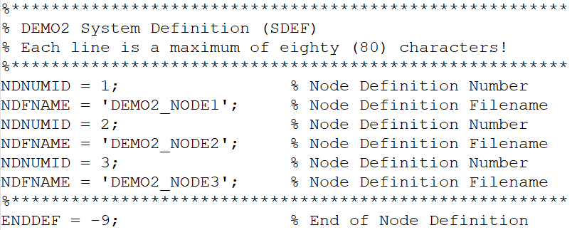
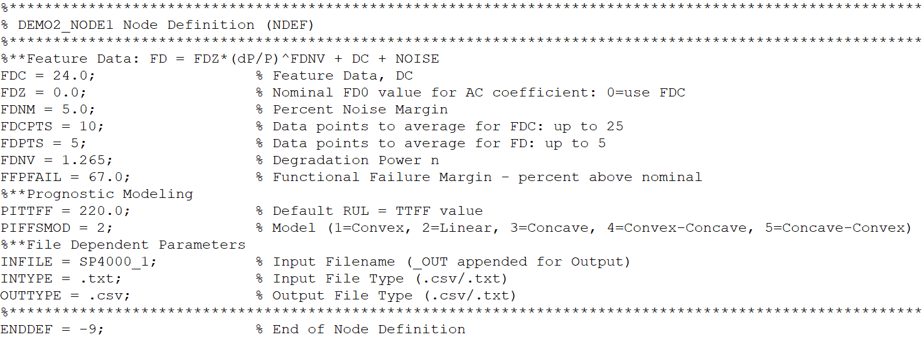
Definition Files and File Structure
UD_ARULE is primarily a table-driven application in which the tables are specified as editable files instead of programmed tables. There are 2 types of editable files (called definition files):
System Definition (SDEF) File:
Defines the number of sensor nodes in the system
Node Definition (NDEF) File:
Defines the name of the file containing input data from the sensor node
Defines the parameters and values to create a node-specific Application Programming Interface (API) structure for interfacing with ARULE 2.0
Creates filenames for an output file, a log file, and system files to support checkpoint/restart and recovery from unexpected end-of- of program events: those names are derived from the SDEF and NDEF filenames
Definition files, input data files, output data files, and special checkpoint (CPT) files are kept in subdirectories of a root directory.
Example of SDEF File.
Example of NDEF File.

Slide 4
System Definition (SDEF) Files
A System Definition (SDEF) defines the nodes of a system and the name of an SDEF file is an input argument to UD_ARULE
Important Note: There is no requirement that a specified NDNUMID have any correlation to its relative position (1st, 2nd, … nth) position in an SDEF file; nor is there any requirement that NDNUMID be a number. The default SDEF filename is ‘DEMO1’
UD_ARULE supports up to 25 system nodes in any SDEF file, which could be increased/decreased upon request on an application basis.

Slide 5
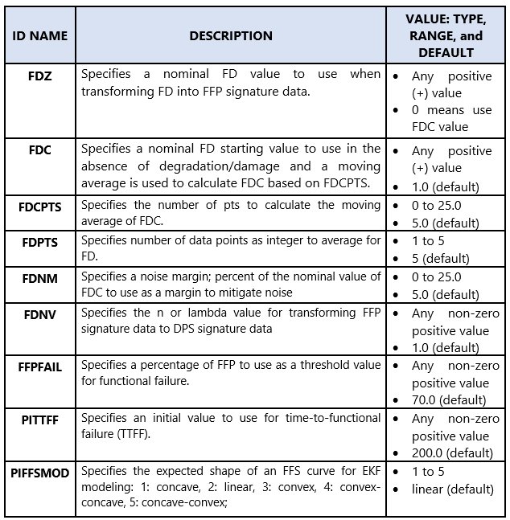
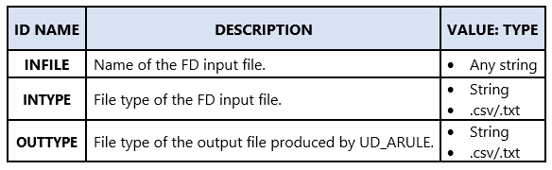
Node Definition (NDEF) Files
A Node Definition (NDEF) defines values for all keywords in node definitions and you only need to specify those keywords specific to your application.
There are two types of keywords and values: Data-dependent and File-dependent
Data-dependent Keywords and Values
File-dependent Keywords and Values

Slide 6
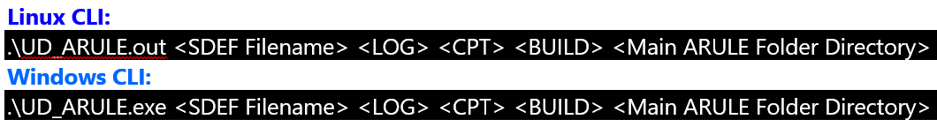
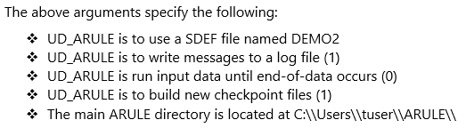
Using UD_ARULE
UD_ARULE can be run on a Linux/Windows machine as an executable file on the Command-Line Interface (CLI).
Linux-based CLI = UD_ARULE.out and Windows-based CLI = UD_ARULE.exe.
UD_ARULE accepts five input arguments:
SDEF Filename
LOG Messages
Checkpoint (CPT) & Restart Operation
BUILD new CPT Files
Main ARULE Directory
SDEF Filename (SDEFFN): Name of dataset containing a System Node Definition (SDEF) in the ARULE\DEFS\SDEF directory.
.txt is the default type
All SDEFFN files are read as sequential text
Default is 'DEMO1'
LOG: Enable/disable logging and displaying that log file.
0 = Does not write to LOGDSN (UD_ARULE_LOG), but displays log messages
1 = Writes to LOGDSN, but does not display log messages
2 = Writes to LOGDSN and displays log messages
Default is 1
CPT MODE: Enable/disable CPT.
0 = Does not perform CPT (Builds new SDEF if not built. Runs all datasets until EOD. If node is at EOD, attempts to resume node.)
N = Perform CPT (Process N data points, checkpoint, exit. Restart from last CPT)
Default is 0, whenever N is not numeric
BUILD: Enable/disable building new .cpt files - SDEF, PW, DW, AW.
0 = Use existing .cpt files, else build new files
1 = Build new .cpt files
Default is 1
GENERAL COMMAND TO CALL UD_ARULE

Slide 7
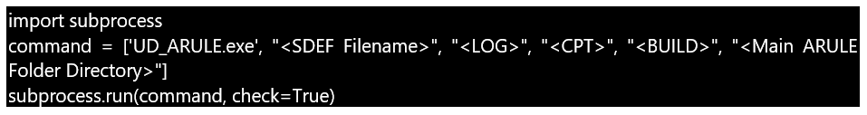
Using UD_ARULE within Python
Another way to execute the UD_ARULE.exe CLI executable could be from within a Python script.
The method described below using the subprocess library is a structured way to invoke the executable with specific parameters and handle any potential errors that may occur during execution.
Important Note: This is the method used in most of this tutorial’s examples – DEMO1, DEMO2, XFD1 and XFDXX
GENERAL COMMAND TO CALL UD_ARULE WITHIN PYTHON
This does the following:
The subprocess module allows you to spawn new processes, connect to their input/output/error pipes, and obtain their return codes
command is a list that contains the executable name (UD_ARULE.exe) followed by its run arguments
Then, the subprocess.run() function is called with the command list as an argument. This function runs the specified command with the given run arguments. The check=True parameter ensures that if the command returns a non-zero exit status (indicating an error), a subprocess.CalledProcessError exception will be raised.

Slide 8
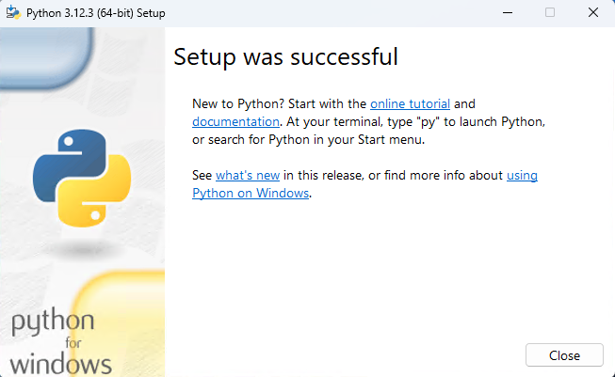
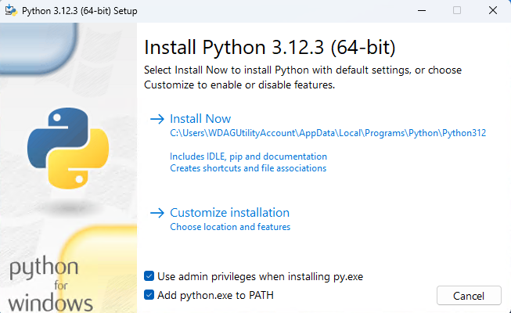

Install Python on Windows
Step 1 – Download the Python Installer
Go to Python Releases for Windows | Python.org
Find a stable Python 3 release. This tutorial was tested with Python version 3.12.3
Click the appropriate link for your system to download the executable file: Windows installer (64-bit) or Windows installer (32-bit)
Step 2 – Running the .exe Installer
After the installer is downloaded, double-click the .exe file, for example python-3.10.10-amd64.exe, to run the Python installer
Select the Use admin privileges when installing py.exe checkbox, which enables all users of the computer to access the Python launcher application
Select the Add python.exe to PATH checkbox, which enables users to launch Python from the command line
Click Install Now
After the installation is complete, a Setup was successful message displays.
Step 3 – Verify the Python Installation
You can verify whether the Python installation is successful either through the command line or through the Integrated Development Environment (IDLE) application, if you chose to install it.
Open Windows Powershell or Command Prompt (cmd) or a Visual Studio (VS) Code terminal
Enter the following command: python –version
If the output is Python X.XX.X (where X.XX.X denotes the version number), you have successfully installed Python on your Windows machine.
Python version check example from this Tutorial.

Slide 9
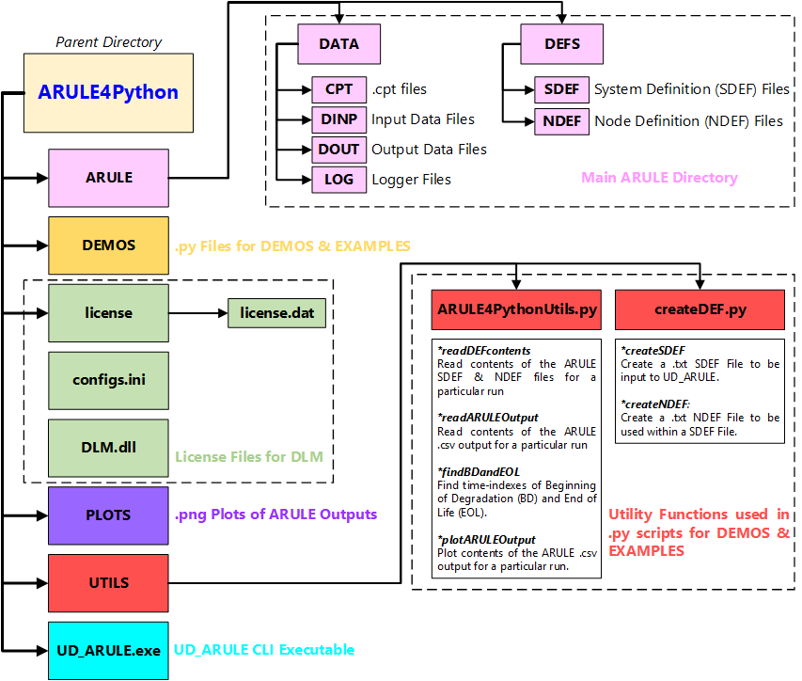
Package File Structure and Dependencies
Clone Package from GitHub
If git is not already installed, install git from the installer at https://git-scm.com/download/win
Open Windows Powershell
Check git exists by running the following command git –version If it exists, output is as follows:
Clone the ARULE4Python directory using the following command - git clone https://github.com/RidgetopGroupInc/ARULE4Python.git
Dependencies
numpy (Numerical Computing)
pip install numpy
(https://numpy.org/doc/stable/)
matplotlib (Data Visualization)
pip install matplotlib (https://matplotlib.org/stable/contents.html)
pandas (Data Analysis)
pip install pandas (https://pandas.pydata.org/pandas-docs/stable/)
Termcolor (Text Color Formatter)
pip install termcolor
Microsoft Visual C++ Redistributable: (https://learn.microsoft.com/en-US/cpp/windows/latest-supported-vc-redist?view=msvc-170#latest-microsoft-visual-c-redistributable-version)

Slide 10
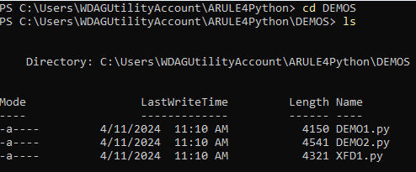
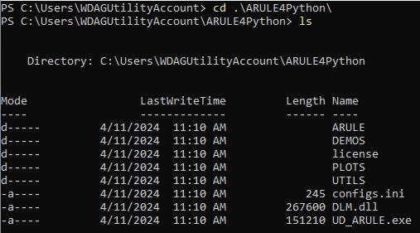
ARULE4Python DEMO
Open Windows Powershell
After the package has been cloned from GitHub as described in the last side, run the following commands to move to that repository directory and check if files have transferred over correctly. The folder structure should be as shown below
Important Note: Most of this tutorial will focus on the DEMO1.py file that sets up one node with a .txt file to be processed by UD_ARULE. Other files follow examples in UG_ARULE_Rev1.7 and can be run to reproduce the same results.
Now, take a deeper look into the DEMO1.py file. Run the following command to open the file in a command line editor or open the file with a word editor such as Notepad++.
Important Note: All the files run as a part of this tutorial are contained in the DEMOS folder. Do not modify anything other than files in that folder without consulting Ridgetop staff
Now, run the following commands to move to the DEMOS directory and check its contents below. The folder structure should be as shown next comprising of DEMO1, DEMO2, and XFD1. More examples from the UG_ARULE_Rev1.7 shall be incorporated soon.
The .py file for a particular demo/example basically carries out the following tasks.
Imports libraries/functions and checks file structure for the main ARULE directory
Creates SDEF & NDEF to be used by UD_ARULE based on user inputs
Calls the executable (UD_ARULE.exe) using the subprocess module
Plots results of the UD_ARULE run (based on user input) and saves it to the PLOTS directory

Slide 11
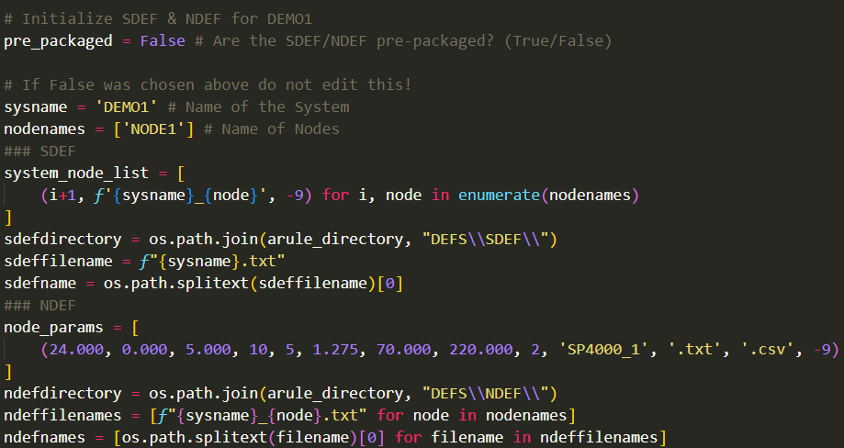
ARULE4Python DEMO – User Inputs into .py FILE
pre_packaged
If NDEF/SDEF files are taken from the ARULE GUI version and already exist within the ARULE/DEFS directory: pre_packaged = True.
If NDEF/SDEF files do not exist within the ARULE/DEFS directory and will be created: pre_packaged = False
Important Note: If pre_packaged = True, do not edit any lines below it.
sysname : Name of the system being analyzed or simply the SDEF name
nodenames: List of node names corresponding to a system – [‘Node1’, ‘Node2’, ……., ‘NodeN’]
node_params
Given as a list of node parameters – (FDC, FDZ, FDNM, FDCPTS, FDPTS, FDNV, FFPFAIL, PITTFF, PIFFSMOD, INFILE, INTYPE, OUTTYPE, ENDDEF)
For multiple nodes it is a list-of list:
[(FDC_{ND1}, FDZ_{ND1}, FDNM_{ND1}, FDCPTS_{ND1}, FDPTS_{ND1}, FDNV_{ND1}, FFPFAIL_{ND1}, PITTFF_{ND1}, PIFFSMOD_{ND1}, INFILE_{ND1}, INTYPE_{ND1}, OUTTYPE_{ND1}, ENDDEF_{ND1}), (FDC_{ND2}, FDZ_{ND2}, FDNM_{ND2}, FDCPTS_{ND2}, FDPTS_{ND2}, FDNV_{ND2}, FFPFAIL_{ND2}, PITTFF_{ND2}, PIFFSMOD_{ND2}, INFILE_{ND2}, INTYPE_{ND2}, OUTTYPE_{ND2}, ENDDEF_{ND2}), ……..]
INFILE sets the input filename of the FD input file from ARULE/DINP and INTYPE sets its type

Slide 12
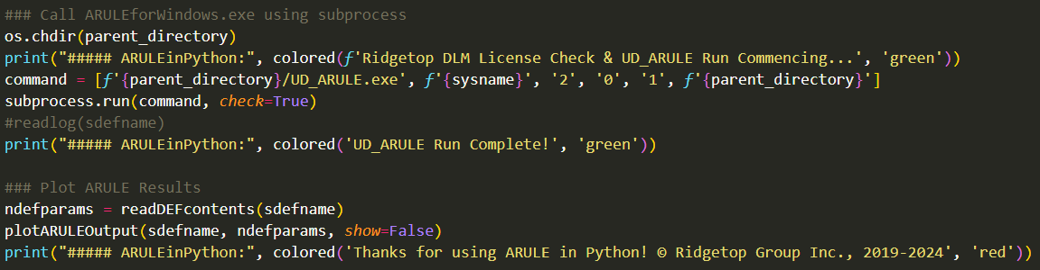
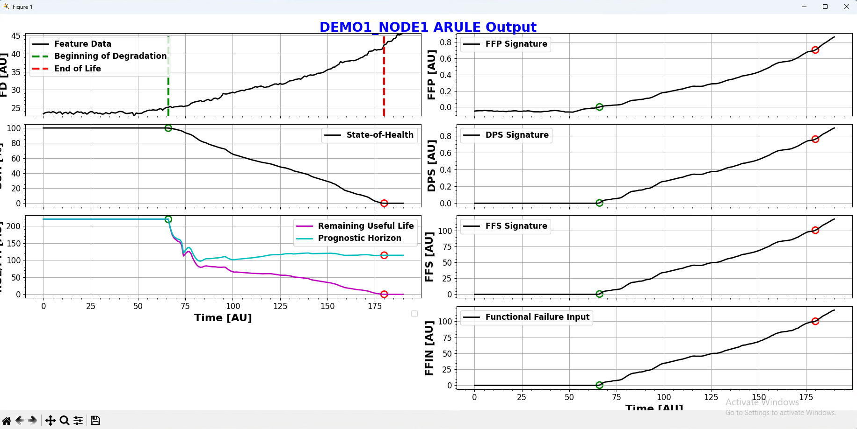
ARULE4Python DEMO – User Inputs into .py FILE
show
If the user does not want to display UD_ARULE outputs plots for all nodes once the run is complete, and rather just save them in the PLOTS directory: show = False
If the user wants to display UD_ARULE outputs plots for all nodes once the run is complete, and also save them in the PLOTS directory: show = True
Plotting Window when show = True

Slide 13
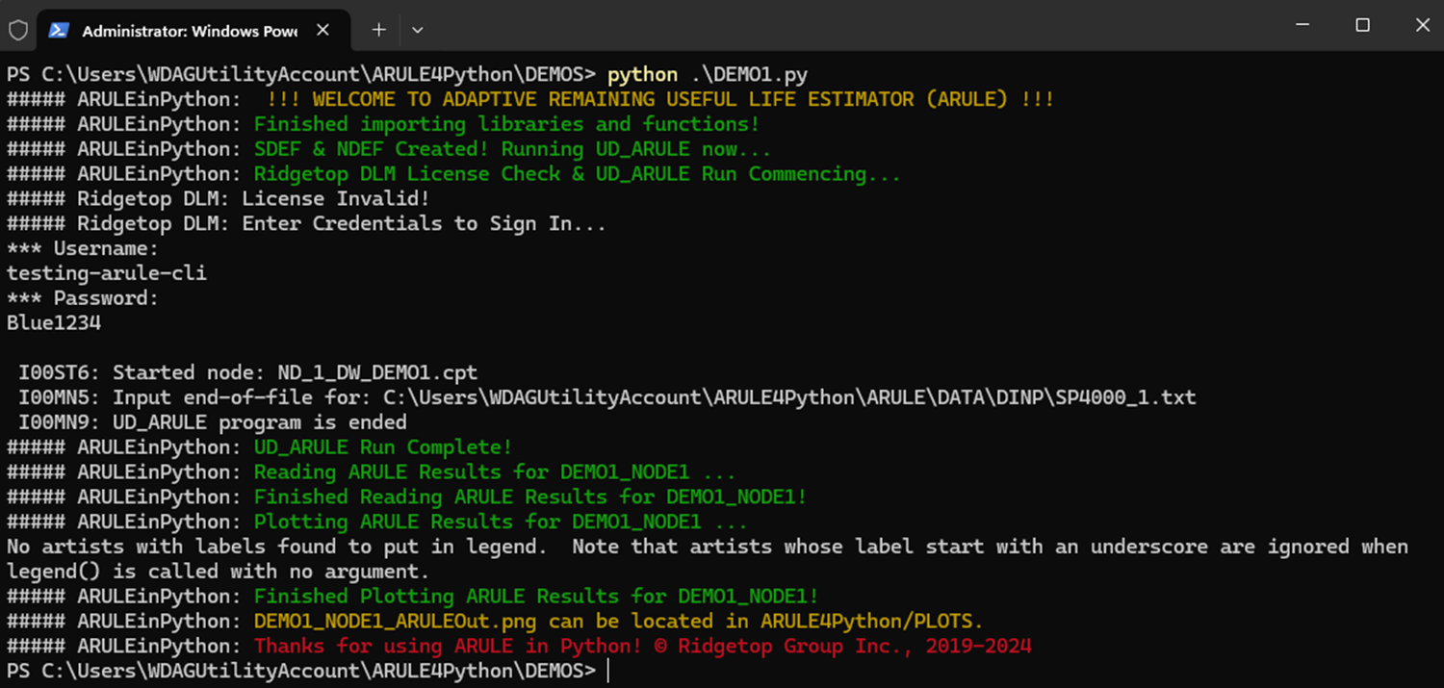
ARULE4Python DEMO
Open Windows Powershell
Change directory to ARULE4Python/DEMOS and run the DEMO1.py file. Shown below is what the terminal output looks like.

Slide 14
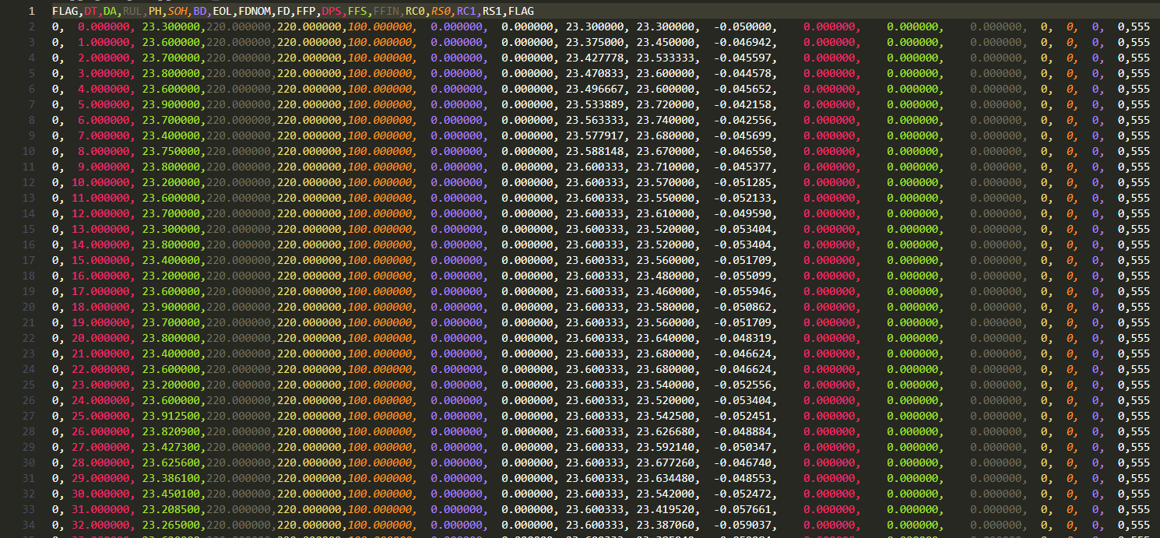
ARULE4Python DEMO
UD_ARULE Output for key prognostic estimates such as RUL, PH, and SoH is saved to ARULE4Python/ARULE/DATA/DOUT as .csv/.txt file depending on what was chosen in the node_params (node parameters).

Slide 15
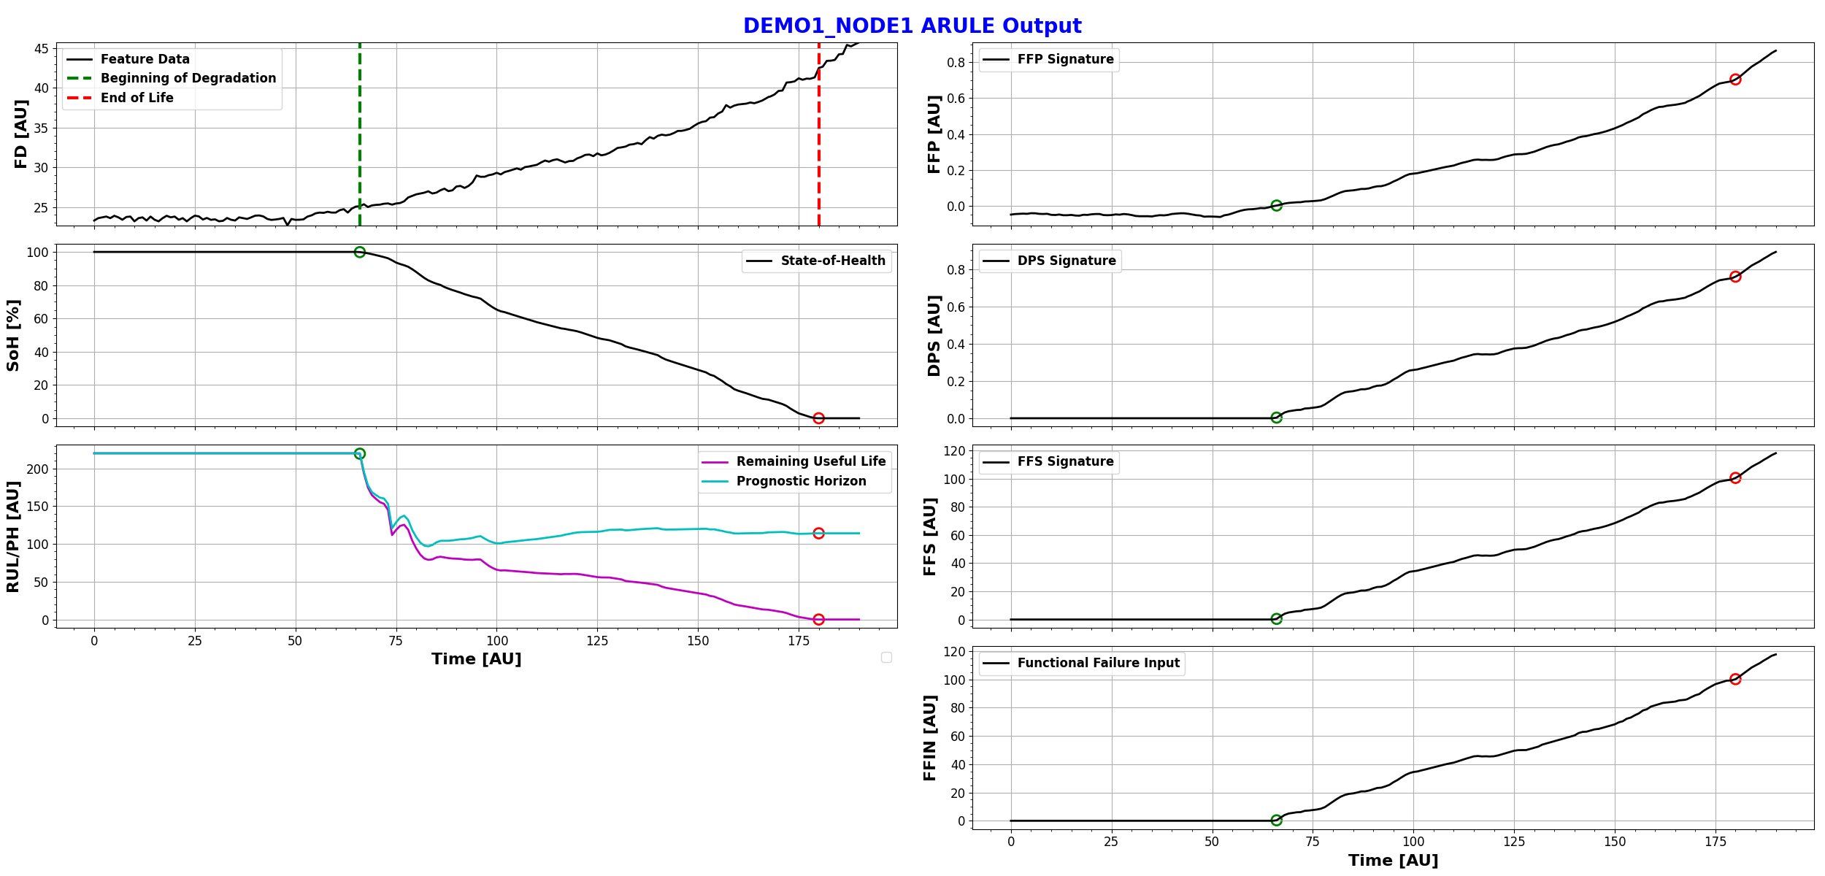
ARULE4Python DEMO
UD_ARULE Output Plot for key prognostic estimates such as RUL, PH, and SoH is saved to ARULE4Python/PLOTS as .png file

Slide 16
Need help with embedding UD_ARULE within your system?
 | Contact | Organization | Email
Technical Support | Arsh Nadkarni | Ridgetop Group Inc. | anadkarni@ridgetopgroup.com
Business/Software Distribution & Licensing | Wyatt Pena | Ridgetop Group Inc. | wpena@ridgetopgroup.com
© Ridgetop Group Inc., 2024

